Slide 1




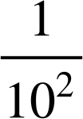

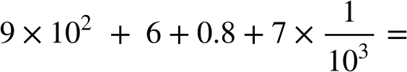

Place value in decimals
Task A: Exponential and fractional forms for decimals
Fill in the gaps so that each column shows a different way of writing the same value.
In fractional form
In decimal form
In exponent form
In words | one tenth | one hundredth
2) Write the following in decimal form:
a)
b)
c)
d)

Slide 2
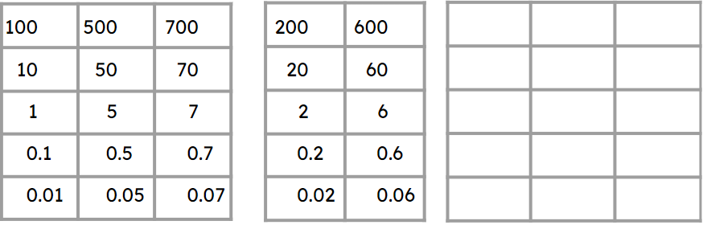
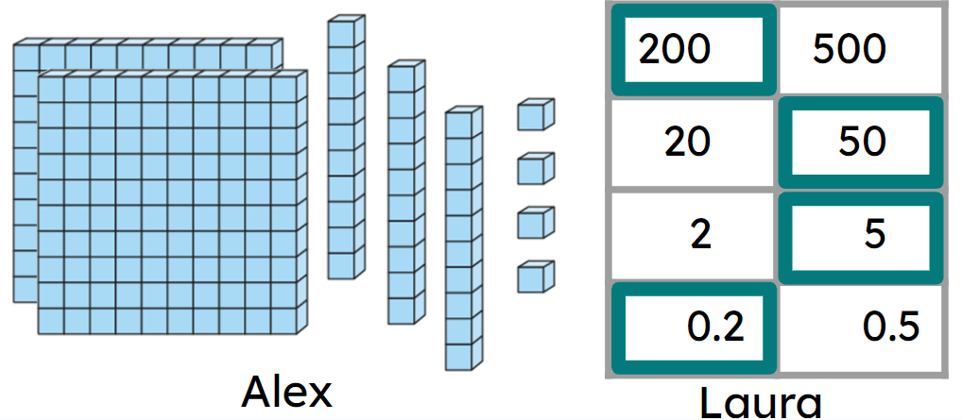
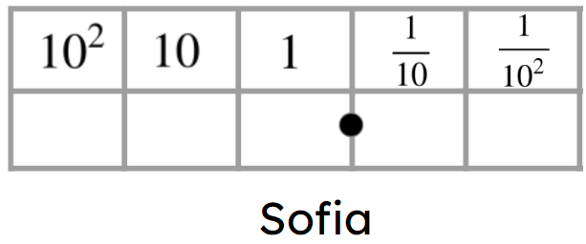
Place value in decimals
Task B: Different representations of decimals
Complete the charts to make the decimals.
751.15
262.26
93.191
2) Three students have different numbers.
Insert all the digits 6, 5, 4 and 2 into Sofia’s place value chart to make:
a) a decimal greater than Laura’s.
b) a decimal less than Alex’s.
c) a decimal in between Alex’s number and Laura’s number.
Try to find more than one answer for each.
Mathematics in Education and Industry
v2.1

